Slide 1






Presented By: Nikhil Zachariah
People10 Technologies Inc.2021

Slide 2
Week 3 15-19 Apr 2024
Key learnings:
Learned Key Concepts Such as waits,Timeouts, Assertions ,Debugging, Advanced Actions
Finished 14.5 hrs worth content on Udemy
Made project based on IFrame , Alerts and window Handling
Automated first Page of Allegiant website
Connected with mentor
Introduced Git & Jira
Provided Guidance & Cleared Doubts
Learned dynamic Xpath and implemented dynamic date selection
Improved the automation of sign up page by adding Fake data
‹#›

Slide 3
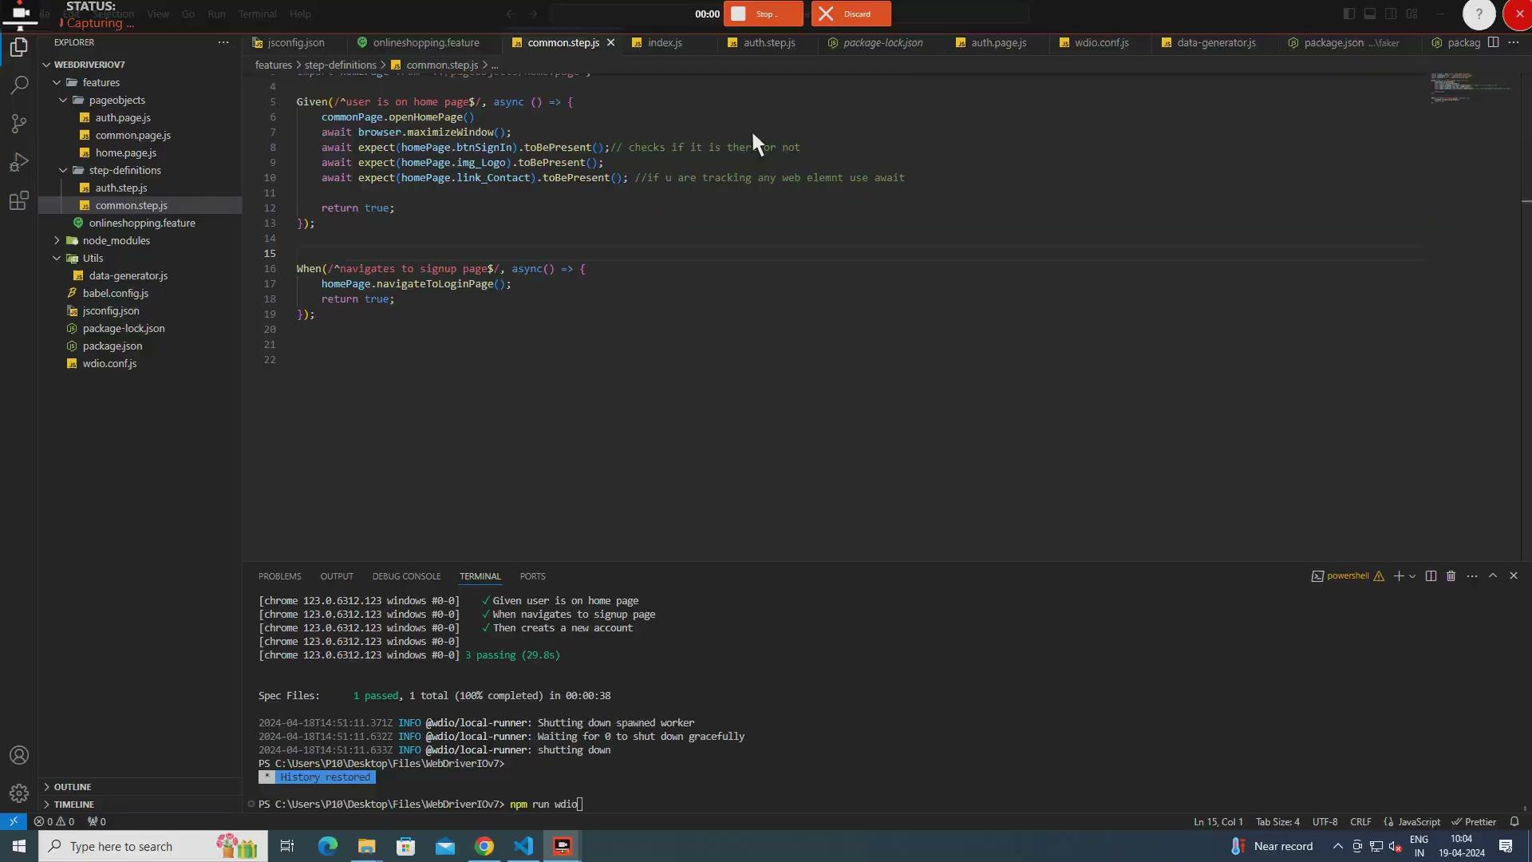
DEMO
Sign Up page

Slide 4
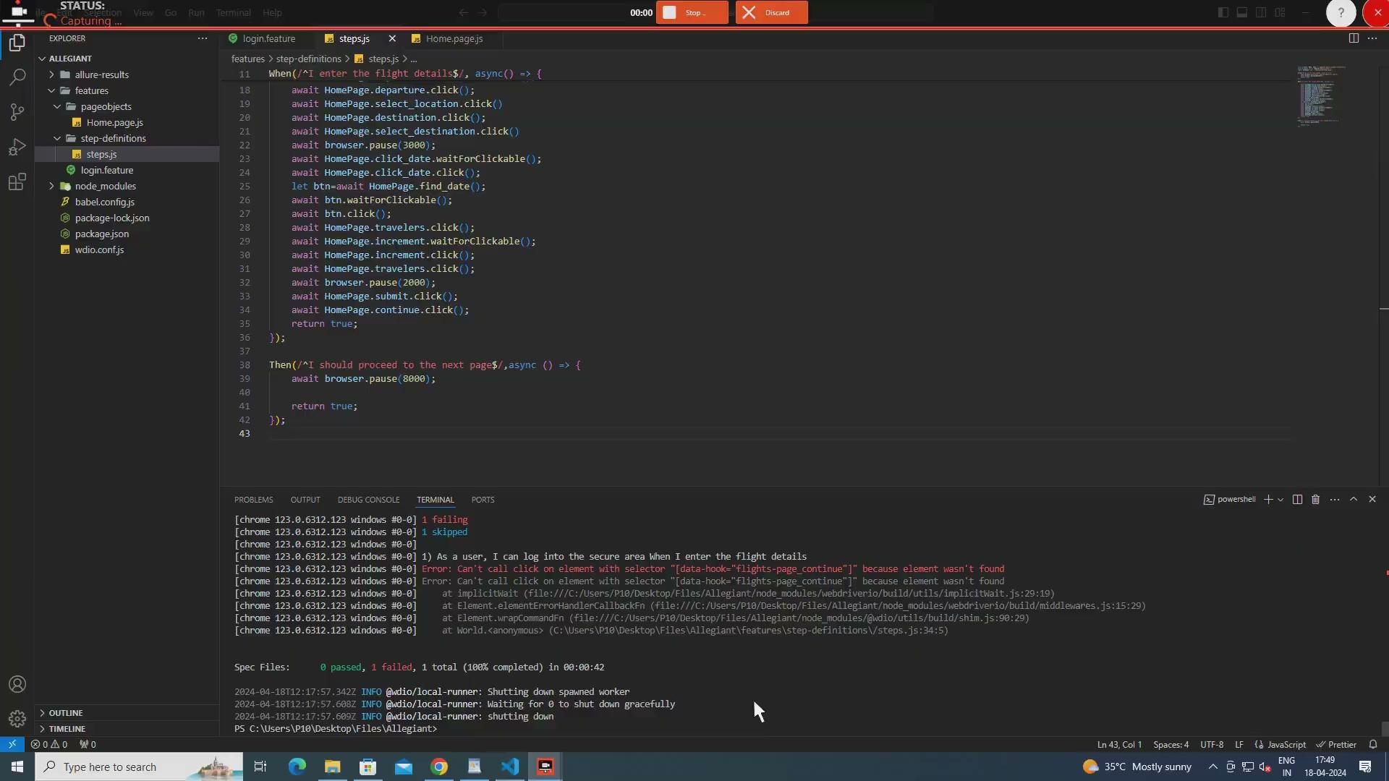
DEMO
Allegiant Website

Slide 5
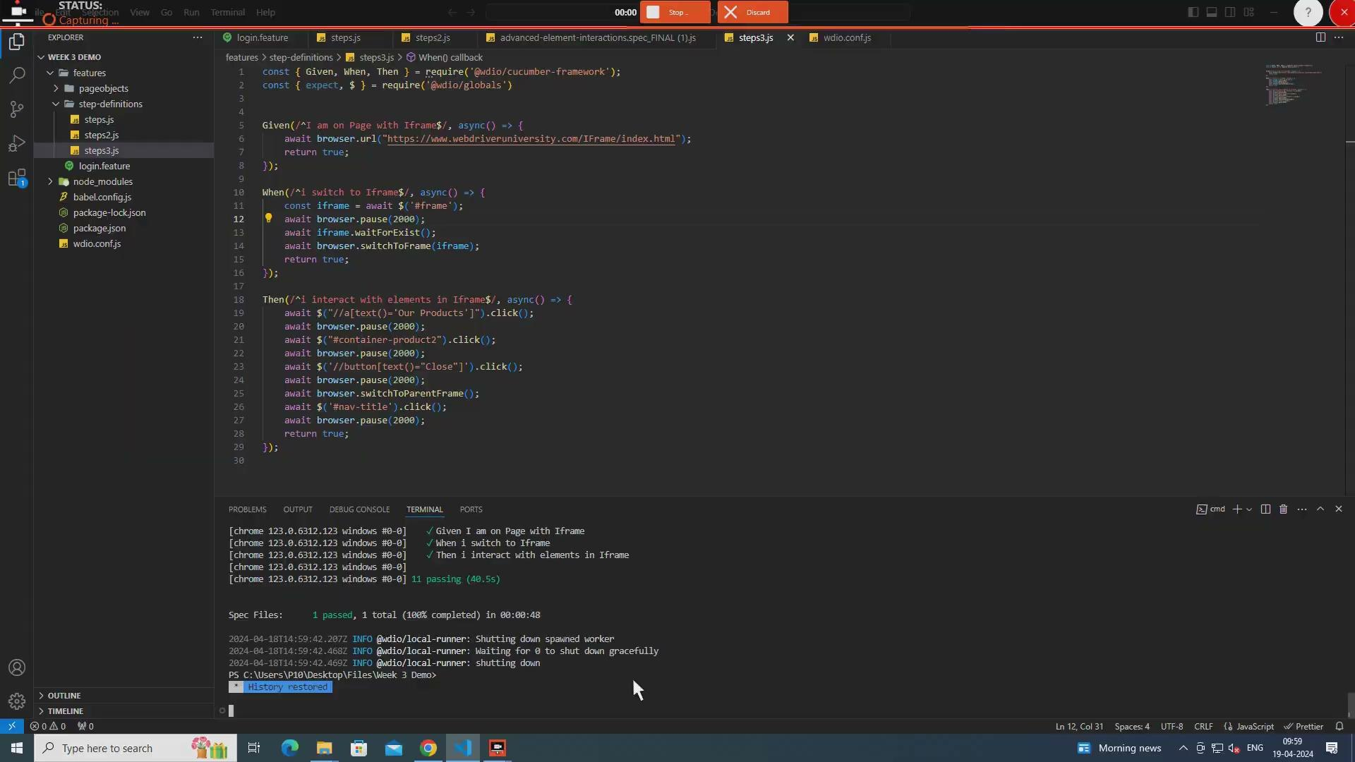
DEMO
Project on IFrame, Window handling, Alert boxes

Slide 6







Thank you
USA
People10 Technologies Inc
Floor 28, 85 Broad Street,
NY, 10004
India
People10 Technosoft Private Limited
Floor 8, Block A, Gopalan Global Axis SEZ,
#152 EPIP Zone, Whitefield,
Bangalore 560066 (India)
Private and Confidential

